Slide 1
A Guide to SQL, Ninth Edition
Chapter One
Introduction to TAL Distributors, Colonial Adventure Tours, and Solmaris Condominium Group

Slide 2
Objectives
Introduce TAL Distributors, a company whose database is used as the basis for many of the examples throughout the text
Introduce Colonial Adventure Tours, a company whose database is used as a case that runs throughout the text
Introduce Solmaris Condominium Group, a company whose database is used as an additional case that runs throughout the text
©2016 Cengage Learning. All Rights Reserved. May not be copied, scanned, or duplicated, in whole or in part, except for use as permitted in a license distributed with a certain product or service or otherwise on a password-protected website for classroom use.

Slide 3
What Is a Database?
Database: a structure containing categories of information and relationships between these categories
Categories: sales reps, customers, orders, and items
Relationships between categories: sales rep-to-customer and customer-to-orders
©2016 Cengage Learning. All Rights Reserved. May not be copied, scanned, or duplicated, in whole or in part, except for use as permitted in a license distributed with a certain product or service or otherwise on a password-protected website for classroom use.

Slide 4
The TAL Distributors Database
TAL distributors is a wholesaler of finely crafted wooden toys, games, and puzzles
Manual system no longer feasible for managing customer, order, and inventory data
Database management system will allow for current, accurate data with useful reports
©2016 Cengage Learning. All Rights Reserved. May not be copied, scanned, or duplicated, in whole or in part, except for use as permitted in a license distributed with a certain product or service or otherwise on a password-protected website for classroom use.

Slide 5
Required Data for Sales Reps
Number
Last name
First name
Address
Total commission
Commission rate
©2016 Cengage Learning. All Rights Reserved. May not be copied, scanned, or duplicated, in whole or in part, except for use as permitted in a license distributed with a certain product or service or otherwise on a password-protected website for classroom use.

Slide 6
Required Data for Customer
Customer number
Name
Address
Current balance
Credit limit
Sales rep number
©2016 Cengage Learning. All Rights Reserved. May not be copied, scanned, or duplicated, in whole or in part, except for use as permitted in a license distributed with a certain product or service or otherwise on a password-protected website for classroom use.

Slide 7
Required Data for Items
Item number
Description
Number of units on hand
Item category
Number of the storehouse where the item is stored
Unit price for each item in inventory
©2016 Cengage Learning. All Rights Reserved. May not be copied, scanned, or duplicated, in whole or in part, except for use as permitted in a license distributed with a certain product or service or otherwise on a password-protected website for classroom use.

Slide 8
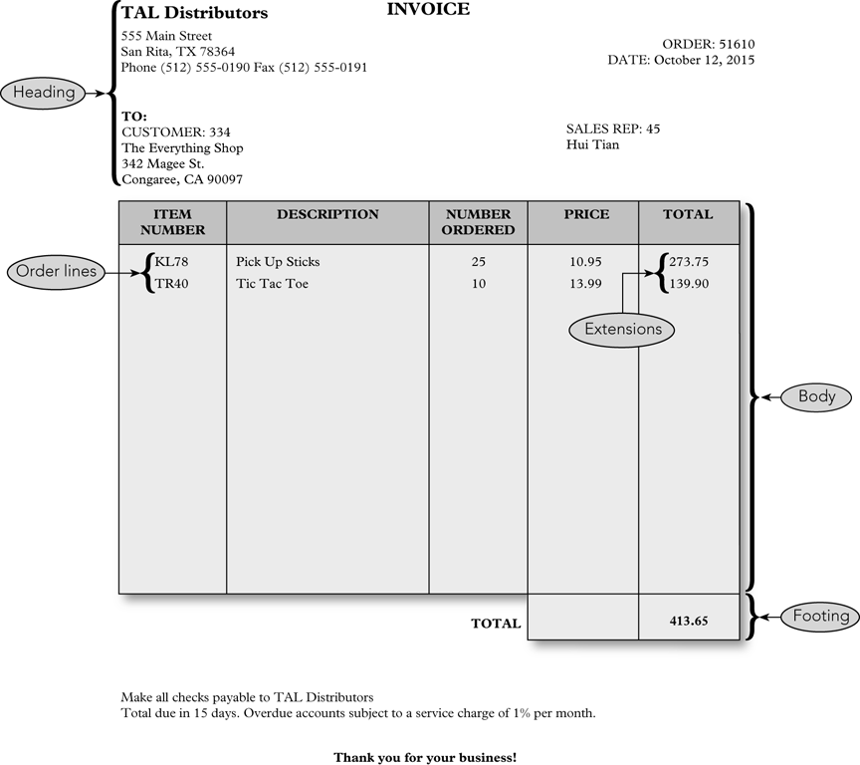
©2016 Cengage Learning. All Rights Reserved. May not be copied, scanned, or duplicated, in whole or in part, except for use as permitted in a license distributed with a certain product or service or otherwise on a password-protected website for classroom use.

Slide 9
Components of a Sample Order
Heading (top of the order form)
  Order number and date
  Customer number, name, address
  Sales rep number and name
Body (center of the order form)
  One or more order lines or line items
Footer (bottom of the order form)
  Order total
©2016 Cengage Learning. All Rights Reserved. May not be copied, scanned, or duplicated, in whole or in part, except for use as permitted in a license distributed with a certain product or service or otherwise on a password-protected website for classroom use.

Slide 10
Components of a Line Item
Item number
Item description
Number of units for the item ordered
Quoted price for the item
Total, or extension, the result of multiplying the number ordered by the quoted price
©2016 Cengage Learning. All Rights Reserved. May not be copied, scanned, or duplicated, in whole or in part, except for use as permitted in a license distributed with a certain product or service or otherwise on a password-protected website for classroom use.

Slide 11
Items Stored for Each Order
Order number
Date of the order
Customer number
Customer name, address, and sales rep information are stored with the customer information
Sales rep name is stored with sales rep information
©2016 Cengage Learning. All Rights Reserved. May not be copied, scanned, or duplicated, in whole or in part, except for use as permitted in a license distributed with a certain product or service or otherwise on a password-protected website for classroom use.

Slide 12
Items Stored for Each Order (continued)
Order number, item number, number of units ordered
Quoted price
Item description is stored with information on items
Order total is not stored but is calculated each time order is displayed or printed
©2016 Cengage Learning. All Rights Reserved. May not be copied, scanned, or duplicated, in whole or in part, except for use as permitted in a license distributed with a certain product or service or otherwise on a password-protected website for classroom use.

Slide 13
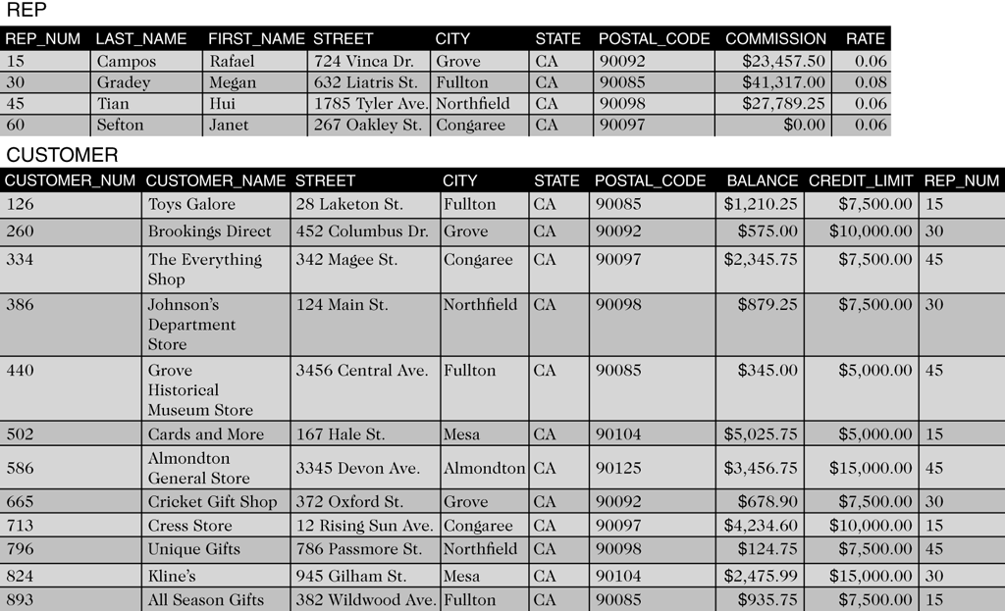
Sample Rep Table
©2016 Cengage Learning. All Rights Reserved. May not be copied, scanned, or duplicated, in whole or in part, except for use as permitted in a license distributed with a certain product or service or otherwise on a password-protected website for classroom use.

Slide 14
Rep Table Example
Three sales reps in the table identified by number
  Sales rep number: 15
  Name: Rafael Campos
  Address: 724 Vinca Dr., Grove, CA 90092
  Total commission: $23,457.50
  Commission rate: 6% (0.06)
©2016 Cengage Learning. All Rights Reserved. May not be copied, scanned, or duplicated, in whole or in part, except for use as permitted in a license distributed with a certain product or service or otherwise on a password-protected website for classroom use.

Slide 15
Sample Customer Table
©2016 Cengage Learning. All Rights Reserved. May not be copied, scanned, or duplicated, in whole or in part, except for use as permitted in a license distributed with a certain product or service or otherwise on a password-protected website for classroom use.

Slide 16
Customer Table Example
Twelve customers are identified by number
  Number: 126
  Name: Toys Galore
  Address: 28 Laketon St., Fullton, CA 90085
  Current balance: $1,210.25
  Credit limit: $7,500.00
  Sales rep: 15 (Rafael Campos)
©2016 Cengage Learning. All Rights Reserved. May not be copied, scanned, or duplicated, in whole or in part, except for use as permitted in a license distributed with a certain product or service or otherwise on a password-protected website for classroom use.

Slide 17
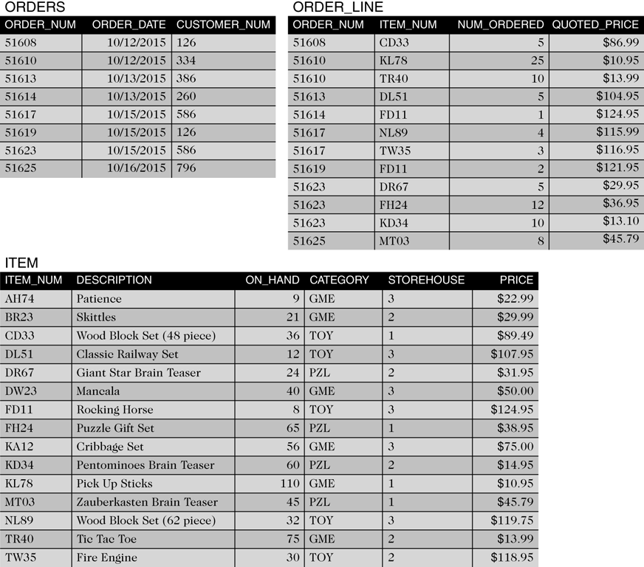
Sample Item Table
©2016 Cengage Learning. All Rights Reserved. May not be copied, scanned, or duplicated, in whole or in part, except for use as permitted in a license distributed with a certain product or service or otherwise on a password-protected website for classroom use.

Slide 18
Item Table Example
Fifteen items are listed by item number
  Item number: AH74
  Description: Patience
  Units on hand: 9
  Category: GME (game)
  Storehouse: 3
  Price: $22.99
©2016 Cengage Learning. All Rights Reserved. May not be copied, scanned, or duplicated, in whole or in part, except for use as permitted in a license distributed with a certain product or service or otherwise on a password-protected website for classroom use.

Slide 19
Sample Orders Table
©2016 Cengage Learning. All Rights Reserved. May not be copied, scanned, or duplicated, in whole or in part, except for use as permitted in a license distributed with a certain product or service or otherwise on a password-protected website for classroom use.

Slide 20
Orders Table Example
Eight orders listed by order number
  Order number: 51608
  Order date: 10/12/2015
  Customer: 126 (Toys Galore)
©2016 Cengage Learning. All Rights Reserved. May not be copied, scanned, or duplicated, in whole or in part, except for use as permitted in a license distributed with a certain product or service or otherwise on a password-protected website for classroom use.

Slide 21
Sample Order_Line Table
©2016 Cengage Learning. All Rights Reserved. May not be copied, scanned, or duplicated, in whole or in part, except for use as permitted in a license distributed with a certain product or service or otherwise on a password-protected website for classroom use.

Slide 22
Order_Line Table Example
Twelve order line items listed by order number
  Order number: 51608
  Item number: CD33 (Wood Block Set (48 piece))
  Number ordered: 5
  Quoted price: $86.99
©2016 Cengage Learning. All Rights Reserved. May not be copied, scanned, or duplicated, in whole or in part, except for use as permitted in a license distributed with a certain product or service or otherwise on a password-protected website for classroom use.

Slide 23
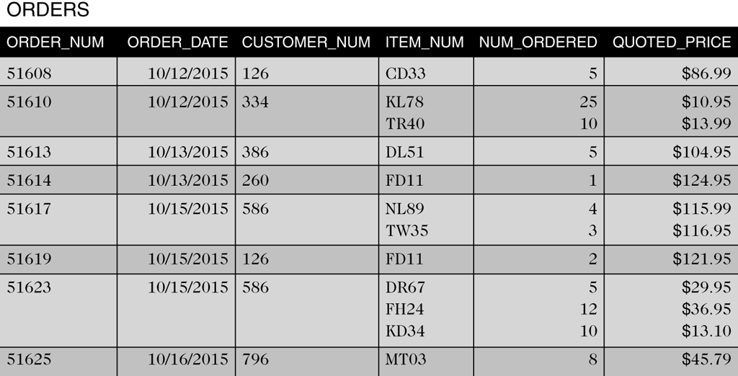
Alternative Orders Table Structure
©2016 Cengage Learning. All Rights Reserved. May not be copied, scanned, or duplicated, in whole or in part, except for use as permitted in a license distributed with a certain product or service or otherwise on a password-protected website for classroom use.

Slide 24
Alternative Order Table Example
  Displays identical data in one table
  Each table row contains all of the order lines for each order
  Second row, order 51610 has two order lines
    Item KL78, Qty 25, Quoted price $10.95 each
    Item TR40, Qty 10, Quoted price $13.99 each
©2016 Cengage Learning. All Rights Reserved. May not be copied, scanned, or duplicated, in whole or in part, except for use as permitted in a license distributed with a certain product or service or otherwise on a password-protected website for classroom use.

Slide 25
Issues with Alternative Order Table
Difficult to track information between columns
Other issues
  How much room is allowed for multiple entries?
  What if an order has more order lines than you have allowed room for?
  For a given item, how do you determine which orders contain order lines for that item?
©2016 Cengage Learning. All Rights Reserved. May not be copied, scanned, or duplicated, in whole or in part, except for use as permitted in a license distributed with a certain product or service or otherwise on a password-protected website for classroom use.

Slide 26
Benefits of Order_Line Table
Table is less complicated when separated
No multiple entries
Number of order lines is not limited
Finding every order for a given item is simple
©2016 Cengage Learning. All Rights Reserved. May not be copied, scanned, or duplicated, in whole or in part, except for use as permitted in a license distributed with a certain product or service or otherwise on a password-protected website for classroom use.

Slide 27
Colonial Adventure Tours Database
Small business that organizes day-long guided trips to New England
Data is to be stored in a database
Needs forms and reports to work with the data
Gathers a variety of information on guides, trips, customers, and reservations
©2016 Cengage Learning. All Rights Reserved. May not be copied, scanned, or duplicated, in whole or in part, except for use as permitted in a license distributed with a certain product or service or otherwise on a password-protected website for classroom use.

Slide 28
Data for Guide Table
Guide number
Last and First names
Address
Phone number
Hire date
©2016 Cengage Learning. All Rights Reserved. May not be copied, scanned, or duplicated, in whole or in part, except for use as permitted in a license distributed with a certain product or service or otherwise on a password-protected website for classroom use.

Slide 29
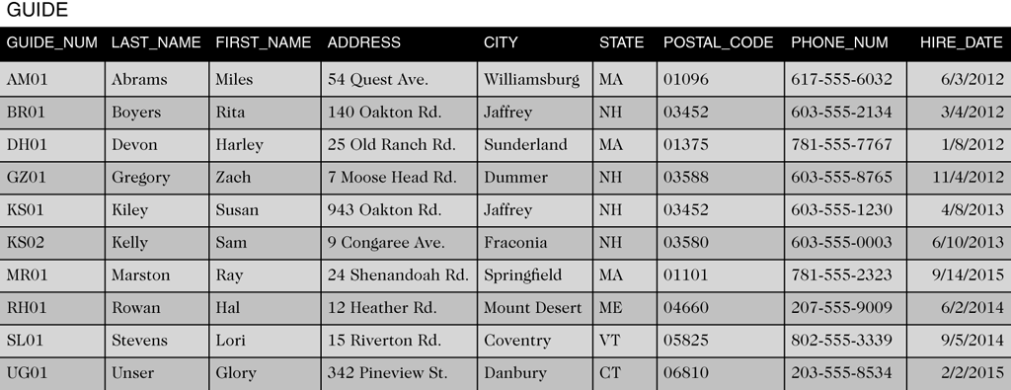
Sample Guide Table
©2016 Cengage Learning. All Rights Reserved. May not be copied, scanned, or duplicated, in whole or in part, except for use as permitted in a license distributed with a certain product or service or otherwise on a password-protected website for classroom use.

Slide 30
Data for Trip Table
Trip ID
Name
Location and State
Distance
Maximum group size
Trip type
Season
©2016 Cengage Learning. All Rights Reserved. May not be copied, scanned, or duplicated, in whole or in part, except for use as permitted in a license distributed with a certain product or service or otherwise on a password-protected website for classroom use.

Slide 31
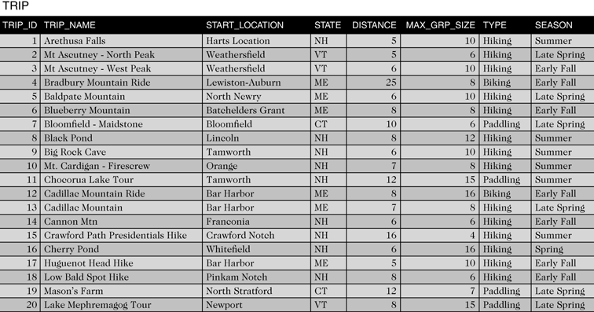
Sample Trip Table
©2016 Cengage Learning. All Rights Reserved. May not be copied, scanned, or duplicated, in whole or in part, except for use as permitted in a license distributed with a certain product or service or otherwise on a password-protected website for classroom use.

Slide 32
Data for Customer Table
Customer number
Last and First names
Address
Phone
©2016 Cengage Learning. All Rights Reserved. May not be copied, scanned, or duplicated, in whole or in part, except for use as permitted in a license distributed with a certain product or service or otherwise on a password-protected website for classroom use.

Slide 33
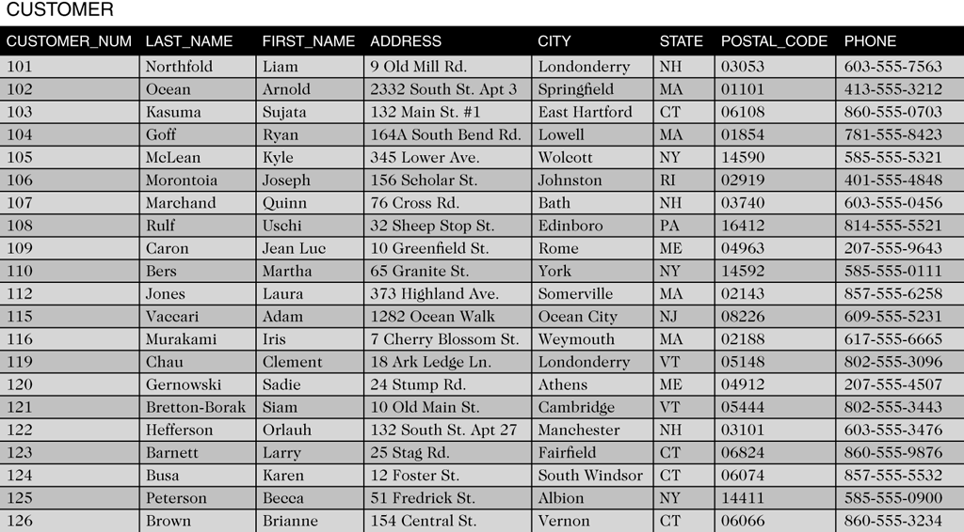
Sample Customer Table
©2016 Cengage Learning. All Rights Reserved. May not be copied, scanned, or duplicated, in whole or in part, except for use as permitted in a license distributed with a certain product or service or otherwise on a password-protected website for classroom use.

Slide 34
Data for Reservation Table
Reservation ID
Trip ID
Trip date
Number of persons
Price
Other fees
Customer number
©2016 Cengage Learning. All Rights Reserved. May not be copied, scanned, or duplicated, in whole or in part, except for use as permitted in a license distributed with a certain product or service or otherwise on a password-protected website for classroom use.

Slide 35
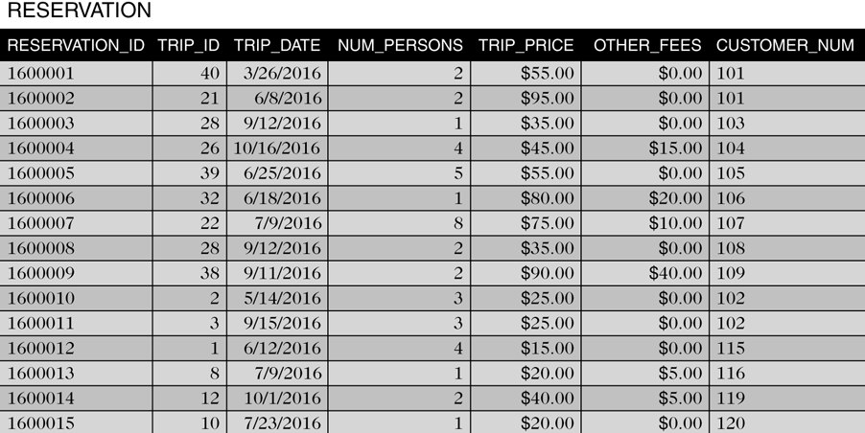
Sample Reservation Table
©2016 Cengage Learning. All Rights Reserved. May not be copied, scanned, or duplicated, in whole or in part, except for use as permitted in a license distributed with a certain product or service or otherwise on a password-protected website for classroom use.

Slide 36
Data for Trip_Guides Table
This table relates trips and guides
  Trip ID
  Guide number
©2016 Cengage Learning. All Rights Reserved. May not be copied, scanned, or duplicated, in whole or in part, except for use as permitted in a license distributed with a certain product or service or otherwise on a password-protected website for classroom use.

Slide 37
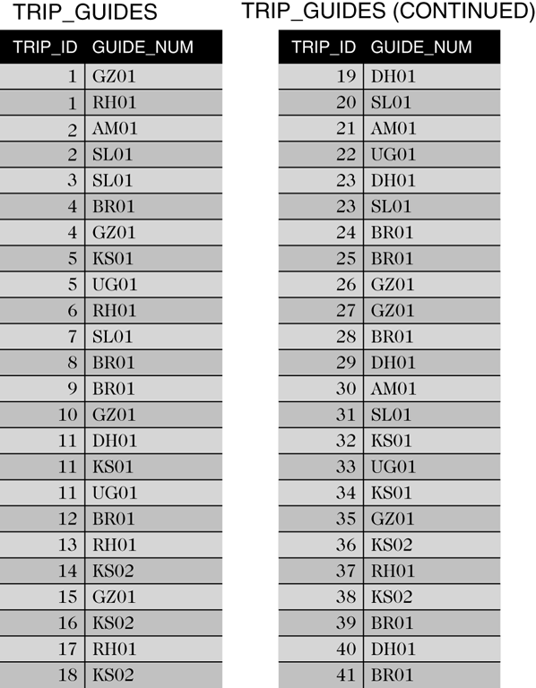
Sample Trip_Guides Table
©2016 Cengage Learning. All Rights Reserved. May not be copied, scanned, or duplicated, in whole or in part, except for use as permitted in a license distributed with a certain product or service or otherwise on a password-protected website for classroom use.

Slide 38
Solmaris Condominium Group Database
Solmaris Condominium Group manages condo complexes
Has two properties and maintains common areas
Also provides maintenance services
Uses database to store information for managing operations
©2016 Cengage Learning. All Rights Reserved. May not be copied, scanned, or duplicated, in whole or in part, except for use as permitted in a license distributed with a certain product or service or otherwise on a password-protected website for classroom use.

Slide 39
Data for Location Table
Location number
Name
Street Address
City, State, and Postal Code
©2016 Cengage Learning. All Rights Reserved. May not be copied, scanned, or duplicated, in whole or in part, except for use as permitted in a license distributed with a certain product or service or otherwise on a password-protected website for classroom use.

Slide 40
Data for Owner Table
Owner number
Last and First names
Street Address
City, State, and Postal Code
©2016 Cengage Learning. All Rights Reserved. May not be copied, scanned, or duplicated, in whole or in part, except for use as permitted in a license distributed with a certain product or service or otherwise on a password-protected website for classroom use.

Slide 41
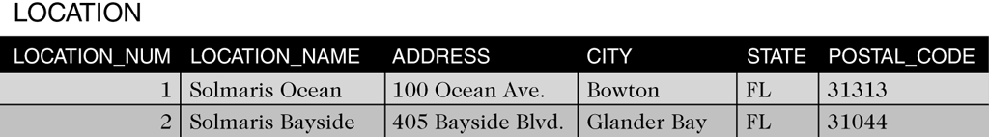
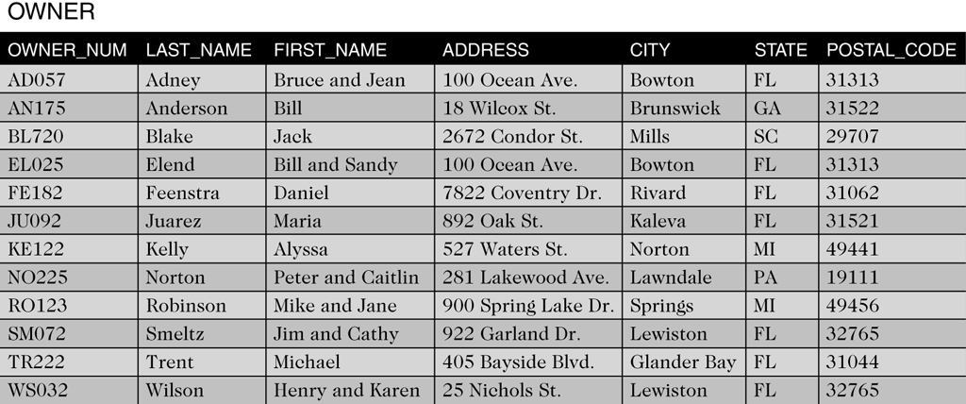
Sample Location and Owner Tables
©2016 Cengage Learning. All Rights Reserved. May not be copied, scanned, or duplicated, in whole or in part, except for use as permitted in a license distributed with a certain product or service or otherwise on a password-protected website for classroom use.

Slide 42
Data for Condo_Unit Table
  Condo ID, Location number, Unit number
  Square footage
  Bedrooms and Baths
  Condo fee
  Owner number
©2016 Cengage Learning. All Rights Reserved. May not be copied, scanned, or duplicated, in whole or in part, except for use as permitted in a license distributed with a certain product or service or otherwise on a password-protected website for classroom use.

Slide 43
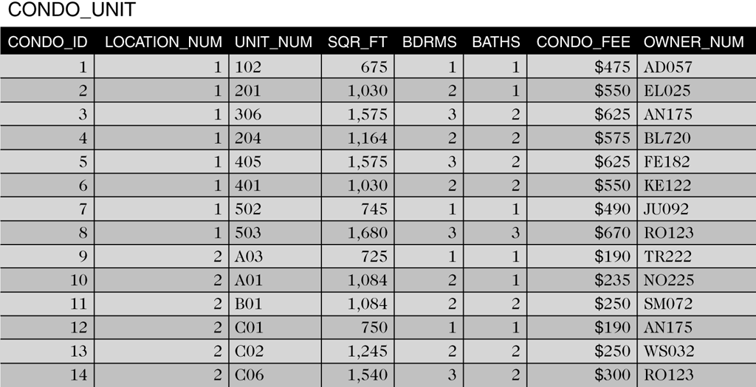
Sample Condo_Unit Table
©2016 Cengage Learning. All Rights Reserved. May not be copied, scanned, or duplicated, in whole or in part, except for use as permitted in a license distributed with a certain product or service or otherwise on a password-protected website for classroom use.

Slide 44
Service Data
Maintenance service category information is stored in the SERVICE_CATEGORY table
Information on the services requested is stored in the SERVICE_REQUEST table
  Stores service category, condo information, description and status, estimated hours, hours spent, and next service date
©2016 Cengage Learning. All Rights Reserved. May not be copied, scanned, or duplicated, in whole or in part, except for use as permitted in a license distributed with a certain product or service or otherwise on a password-protected website for classroom use.

Slide 45
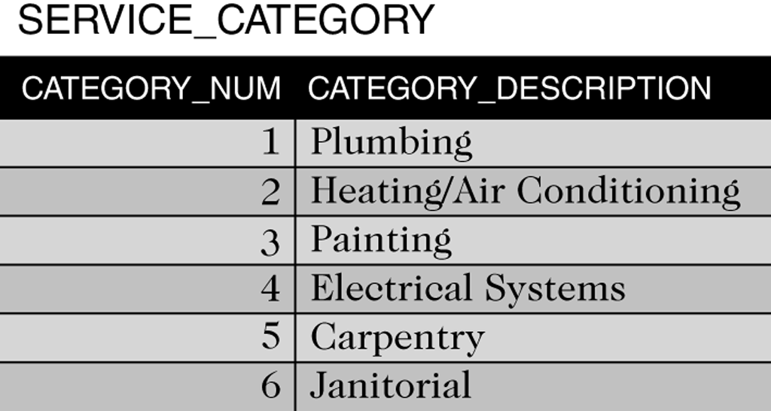
Sample Service_Category Table
©2016 Cengage Learning. All Rights Reserved. May not be copied, scanned, or duplicated, in whole or in part, except for use as permitted in a license distributed with a certain product or service or otherwise on a password-protected website for classroom use.

Slide 46
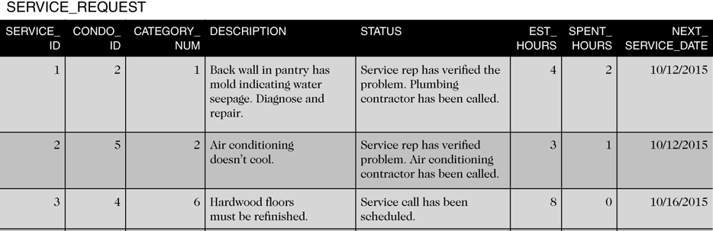
Sample Service_Request Table
©2016 Cengage Learning. All Rights Reserved. May not be copied, scanned, or duplicated, in whole or in part, except for use as permitted in a license distributed with a certain product or service or otherwise on a password-protected website for classroom use.

Slide 47
Summary
TAL Distributors
  Requires rep, customer, items, orders, and order lines
Colonial Adventure Tours
  Requires guide, trip, customer, and reservations
Solmaris Condominium Group
  Requires condo, owners, condo units, service categories, and service requests
©2016 Cengage Learning. All Rights Reserved. May not be copied, scanned, or duplicated, in whole or in part, except for use as permitted in a license distributed with a certain product or service or otherwise on a password-protected website for classroom use.

